Slide 1

Dharmsinh Desai University, Nadiad
Faculty of Technology
Department of Computer Engineering
Btech. CE Semester – VI
Subject: System Design Practices
Project Title: HR Management System
By
Thakkar Anish , CE088 , ID No. 22CEUON124
Vaibhav Makwana , CE024 , ID No. 22CEUBG138
Guided by: Prof. Jigar M. Pandya, Associate Professor

Slide 2
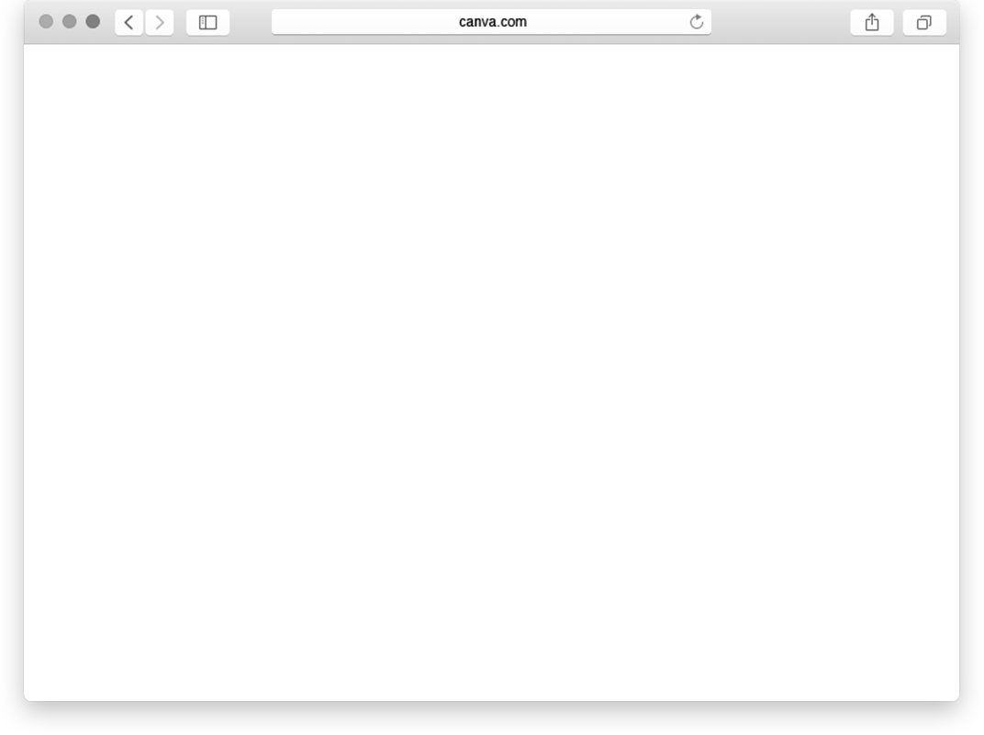

HR Management System

Slide 3

1
Introduction

Slide 4
The HR Management System (HRMS) is built on .NET Core, providing a seamless solution for managing employee and applicant data. It replaces traditional manual processes and integrates smoothly with existing IT systems. Accessible via standard web browsers, the system streamlines HR operations efficiently.

Slide 5
Tech Stack

Slide 6

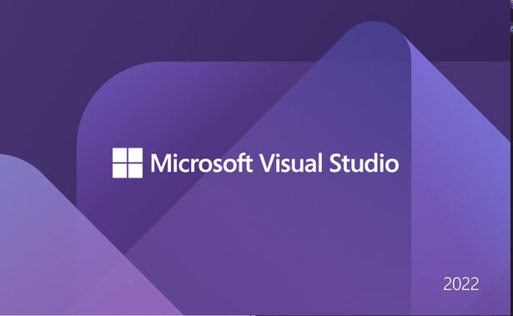



.NET Core with Entity Framework Core
Angular
SQL Server Management Studio
.NET Identity Library
Swagger
Azure

Slide 7
Modules

Slide 8
Attendance
Payroll
Organization Settings
Authentication and Authorization
Deployement

Slide 9
Work Distribution

Slide 10
Employee CRUD
Department CRUD
Payroll calculation and optimization
Deployment in Azure
VAIBHAV
Users CRUD
Attendance update with Excel sheets
Authorization and authentication
Holidays management
ANISH

Slide 11
Architecture

Slide 12
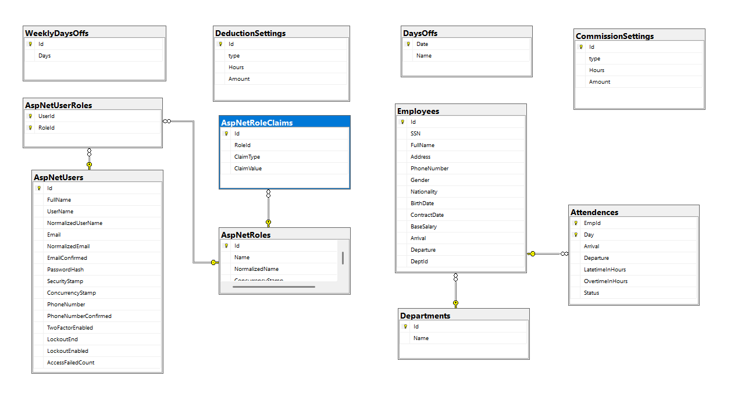
ER Diagram

Slide 13
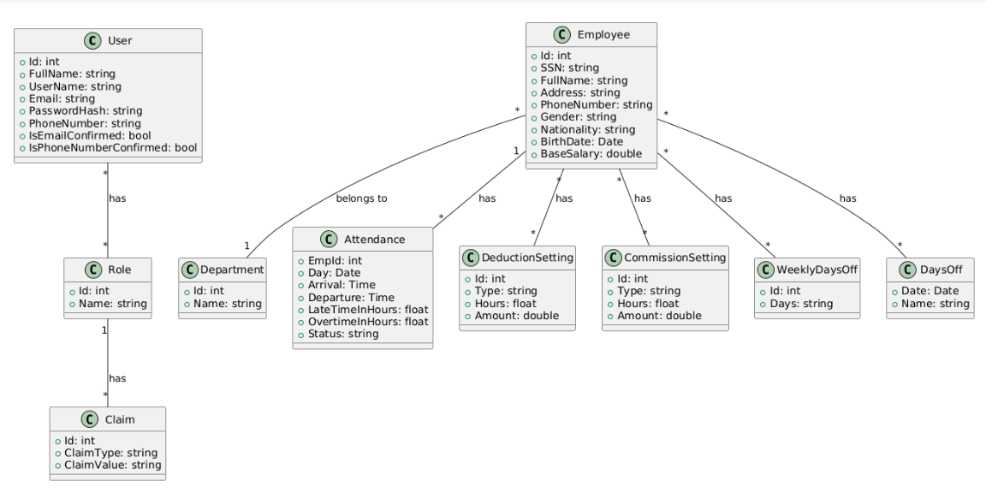
Class Diagram

Slide 14
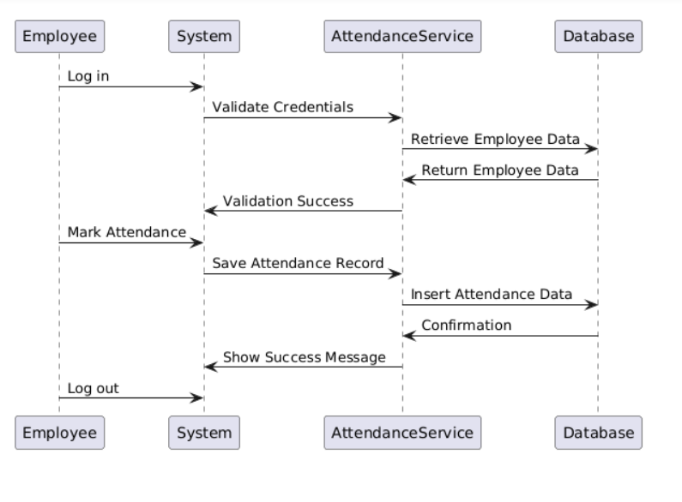
Sequence Diagram - Attendence Management

Slide 15
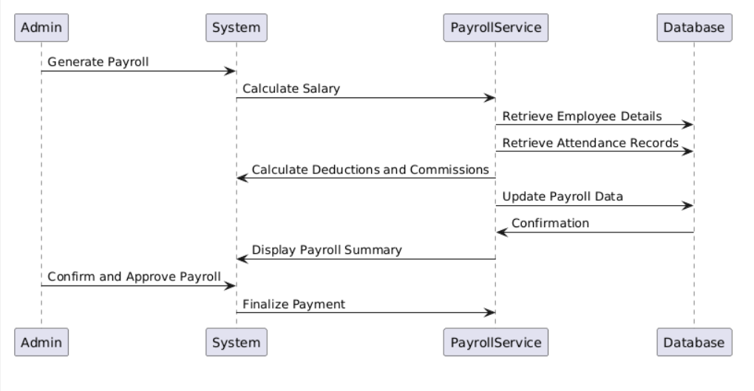
Sequence Diagram - Payroll Management

Slide 16
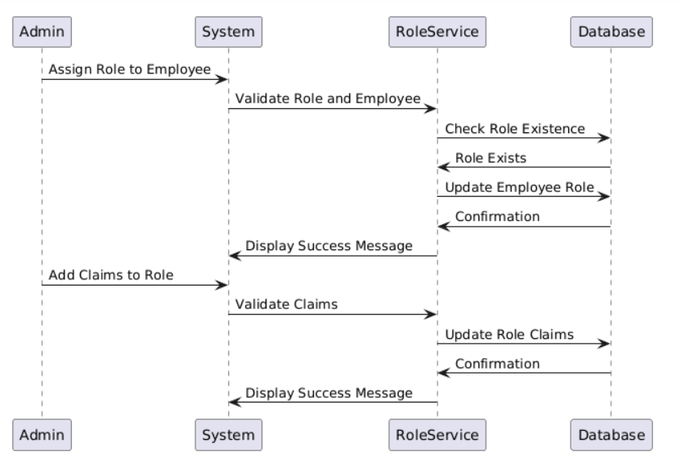
Sequence Diagram - Roles Management

Slide 17
Special Bits

Slide 18
Bulk Update of Attendance uses the same excel format as generated by Biometric Attendance System
Payroll Calculation using Stored Procedures on Database Server, for optimized operation over large dataset

Slide 19
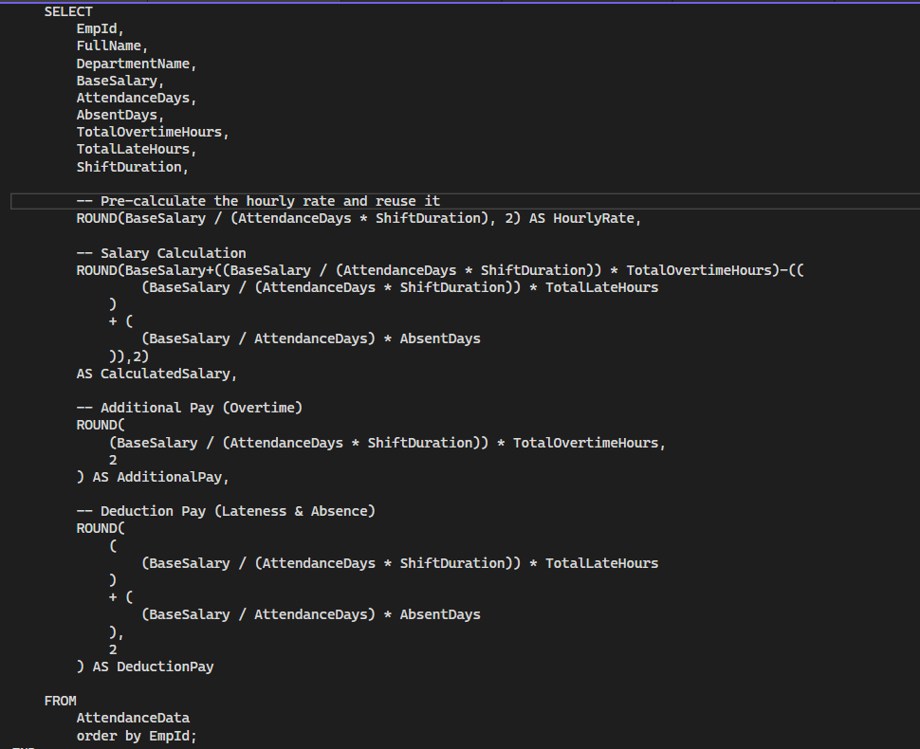

Slide 20
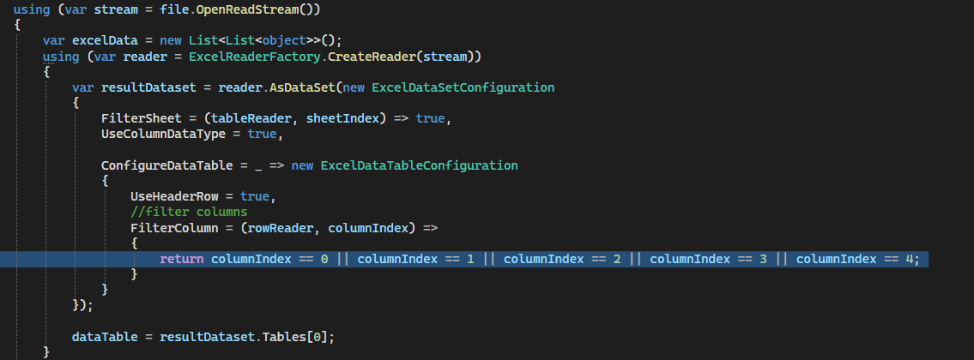

Slide 21
Deployment

Slide 22
The HR Management System (HRMS) is hosted on Microsoft Azure, using SQL Server and SQL Database for data management. Built with .NET 8, the backend is an Azure Web App, and the Angular frontend is also hosted in Azure. This setup enhances monitoring, cost-efficiency, integration, scalability, and security.

Slide 23
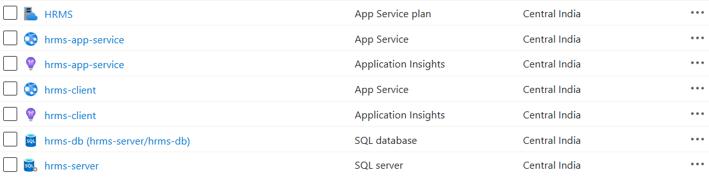

Slide 24
Screenshots

Slide 25
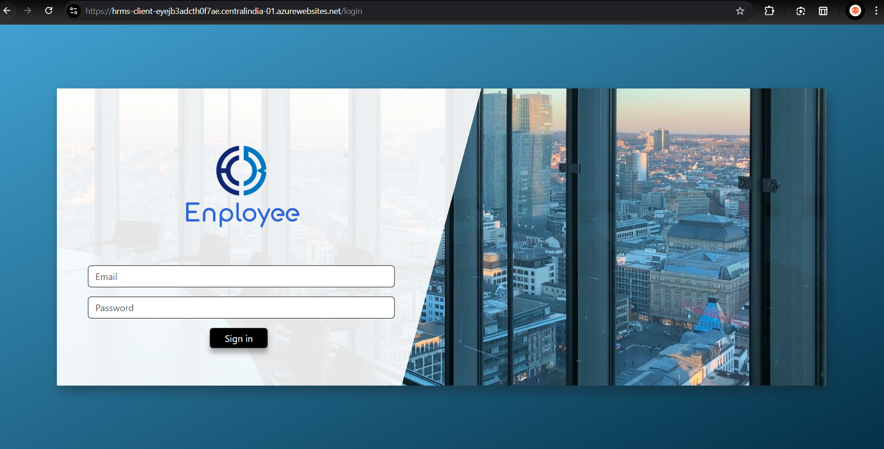

Slide 26
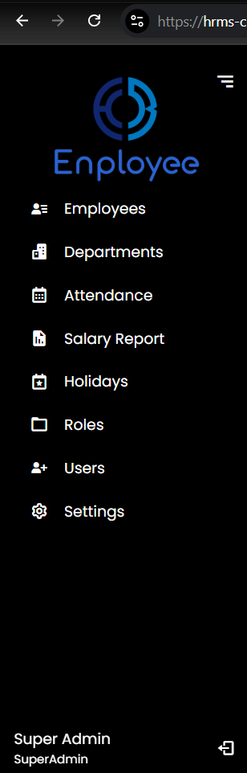
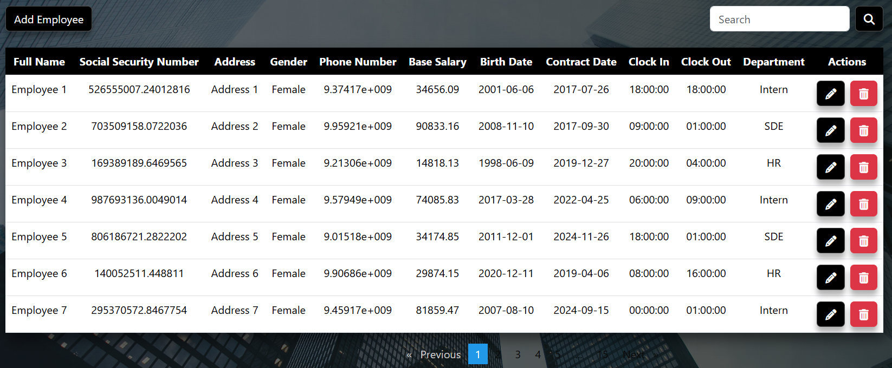

Slide 27
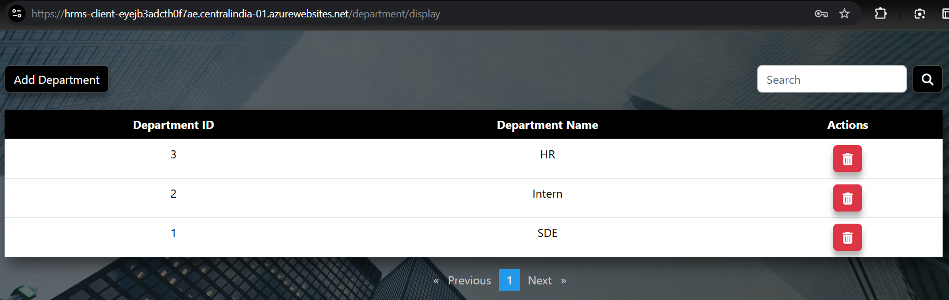

Slide 28
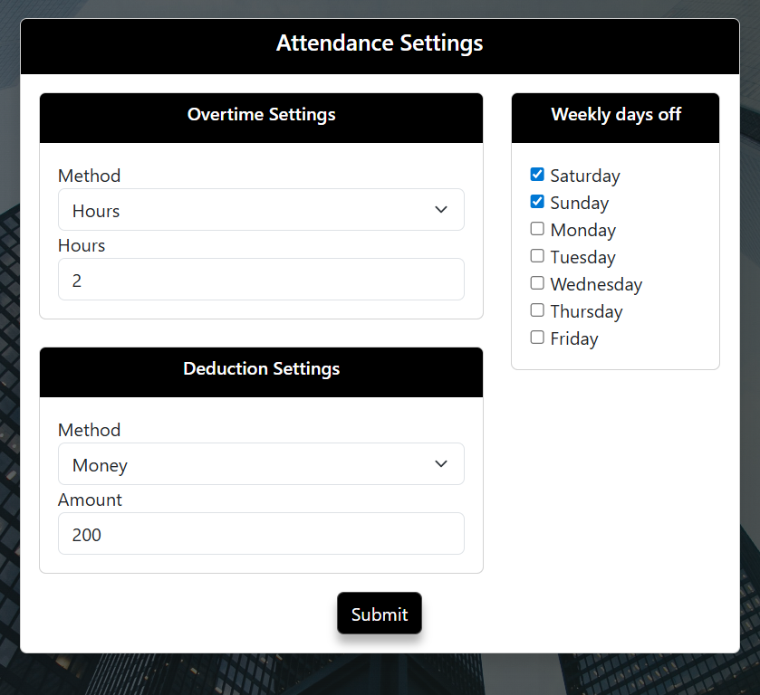

Slide 29
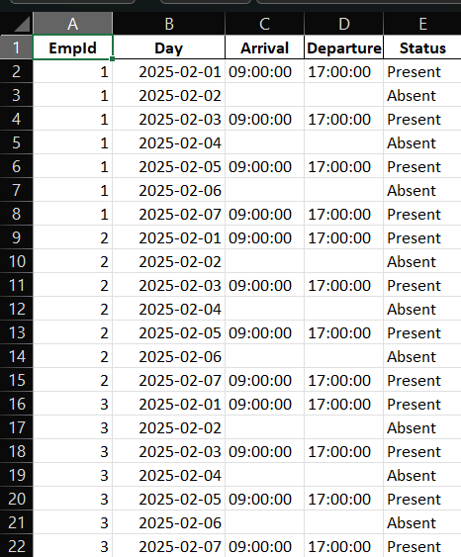

Slide 30
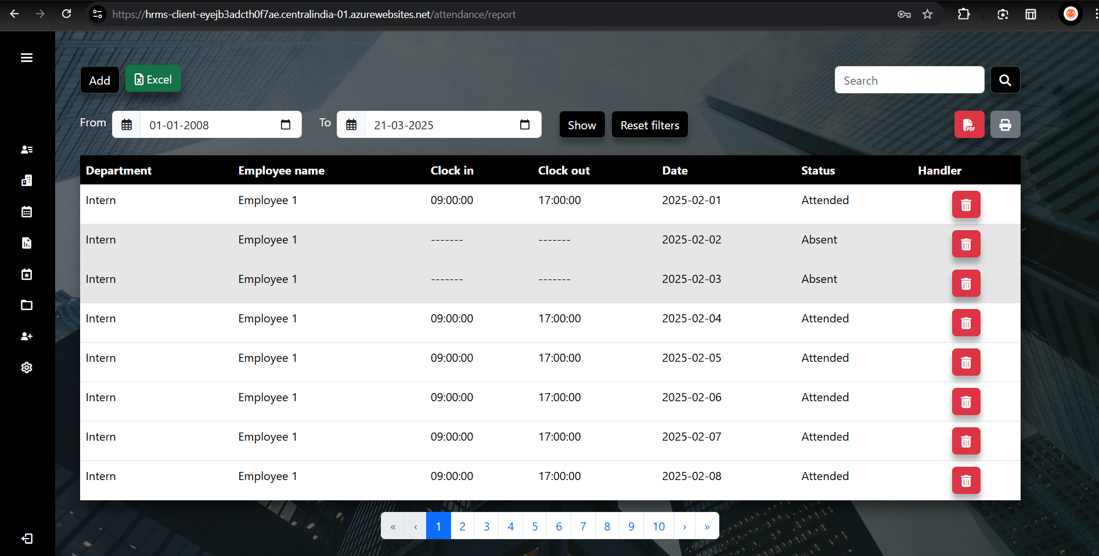

Slide 31
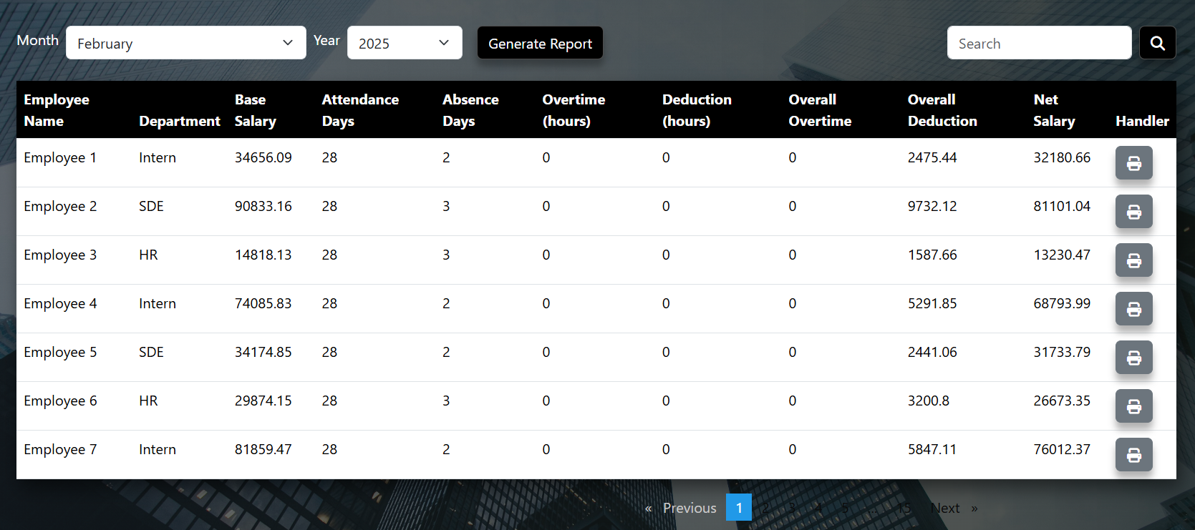

Slide 32
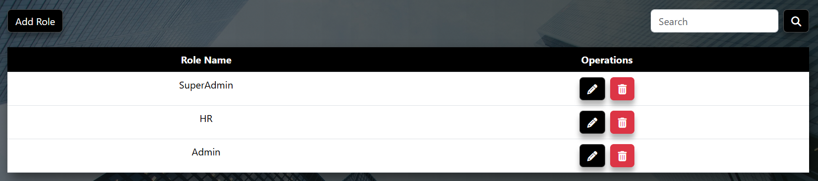
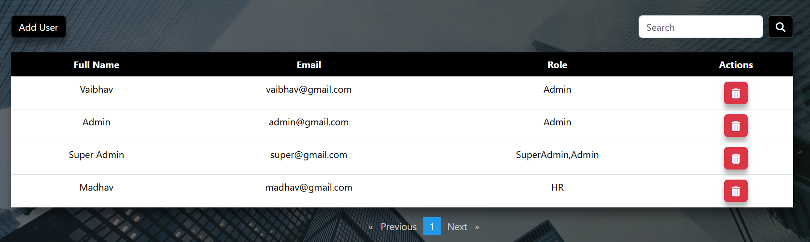

Slide 33
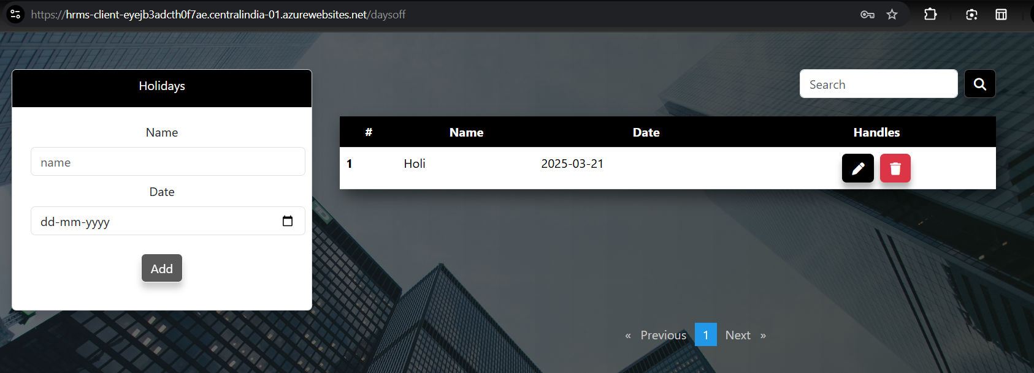

Slide 34
Challenges Faced
Notes:
too much time taken in payroll calculation
integration issues

Slide 35
Future Extensions
Notes:
chat bot integration
concurrency, multithreading

Slide 36
Thank You
Anish Thakkar (CE082)
Vaibhav Makwana (CE024)

